Slide 2
Mastering Azure networking concepts
AI-CI-TS336
Jon Ormond, Principal PM
Azure Networking

Slide 3
Session learning objectives
Business Problems:
Contoso has two on-premise branch offices that need to connect to their Azure deployments.
Site 1 has a NetFoundry appliance (vWAN partner appliance)
Site 2 has a Cisco CSR router (not a vWAN partner appliance)
Contoso also has remote employees at home and is planning for an ExpressRoute circuit
At the end of this session, you should be better able to…
discuss Azure Virtual WAN, when to use and why
talk about the hub and spoke model in vWAN
describe the partner device onboarding experience
describe the manual tunnel process
awareness of the P2S process
awareness of ExpressRoute connections
Notes:
Audience questions:
Who is here for Global Reach? (can anyone tell me what Global Reach is?)
Who is here for Front Door? (can anyone tell me what Front Door is?)
Who is here for both? You’re my people! ☺
Anything we should put in the parking lot to cover if time allows?

Slide 4
Azure PowerShell SDK Update

Slide 5
New Azure PowerShell SDK - Az
New Azure PowerShell SDK Module - Az
Not compatible with AzureRM (ie can’t be installed side by side)
There is an alias set, so AzureRM commands will still work
It’s not required now, but new features are going into Az only
New Azure Login Method
Connect-AzAccount
Do this in an admin PowerShell console session to give permanent access for a machine
AzureRM commands should work with Enable-AzureRmAlias
https://azure.microsoft.com/blog/how-to-migrate-from-azurerm-to-az-in-azure-powershell/

Slide 6
Idempotent PowerShell Operations
# 3.3 Create Public IPs
Write-Host (Get-Date)' - ' -NoNewline
Write-Host “Creating Public IP address“ -ForegroundColor Cyan
Try {$pip = Get-AzPublicIpAddress -ResourceGroupName $ResourceGroup `
-Name $VMNameASH'-pip' -ErrorAction Stop
Write-Host "resource exists, skipping“
}
Catch {$pip = New-AzPublicIpAddress -ResourceGroupName $ResourceGroup `
-Location $EastRegion `
-AllocationMethod Dynamic `
-Name $VMNameASH'-pip’
}

Slide 7
Building the Environment

Slide 8
Final Environment

Slide 9
Step 0
Execution:
Connect to WiFi
Browse to https://portal.azure.com
Get user name and password in KeyVault
Using those creds, RDP to VM01 in VPN Site 1
On VM01, open PowerShell run Connect-AzAccount
Login using @microsoft.com
Run
Get-AzResourceGroup –Name “CompanyXX”
to validate PowerShell and your access
(You may need to Set-AzContext to
"Virtual Data Center Workshop“)
NOTE: VM01 should be the server from
which all PowerShell and any
validation should be performed.

Slide 10
Step 1
Execution:
Open WorkshopStep1.ps1 in PowerShell ISE
(at C:\vdcWorkshop\Scripts)
Run WorkshopStep1.ps1

Slide 11
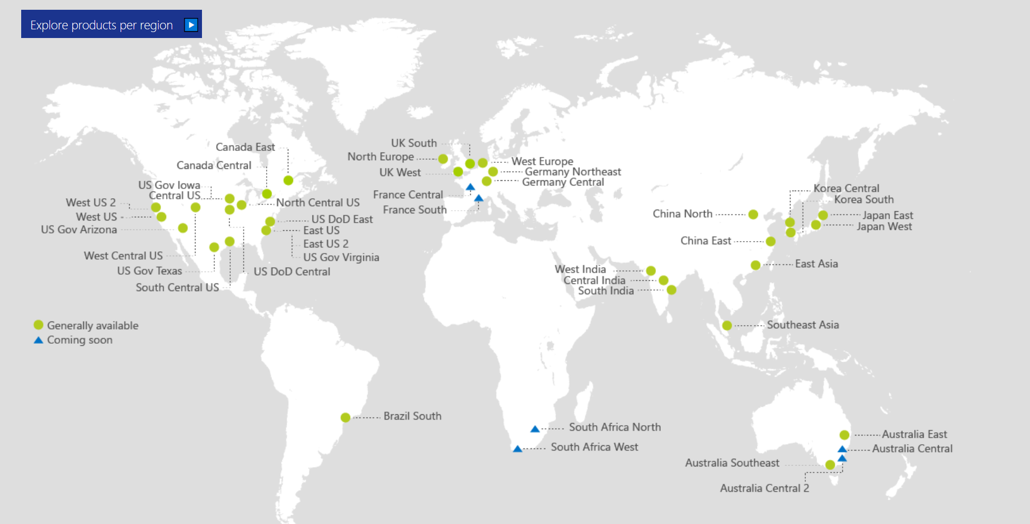
Also Announced:
Germany North
Germany West Central
Switzerland North
Switzerland West
Norway East
Norway West
UAE Central
UAE North

Slide 12
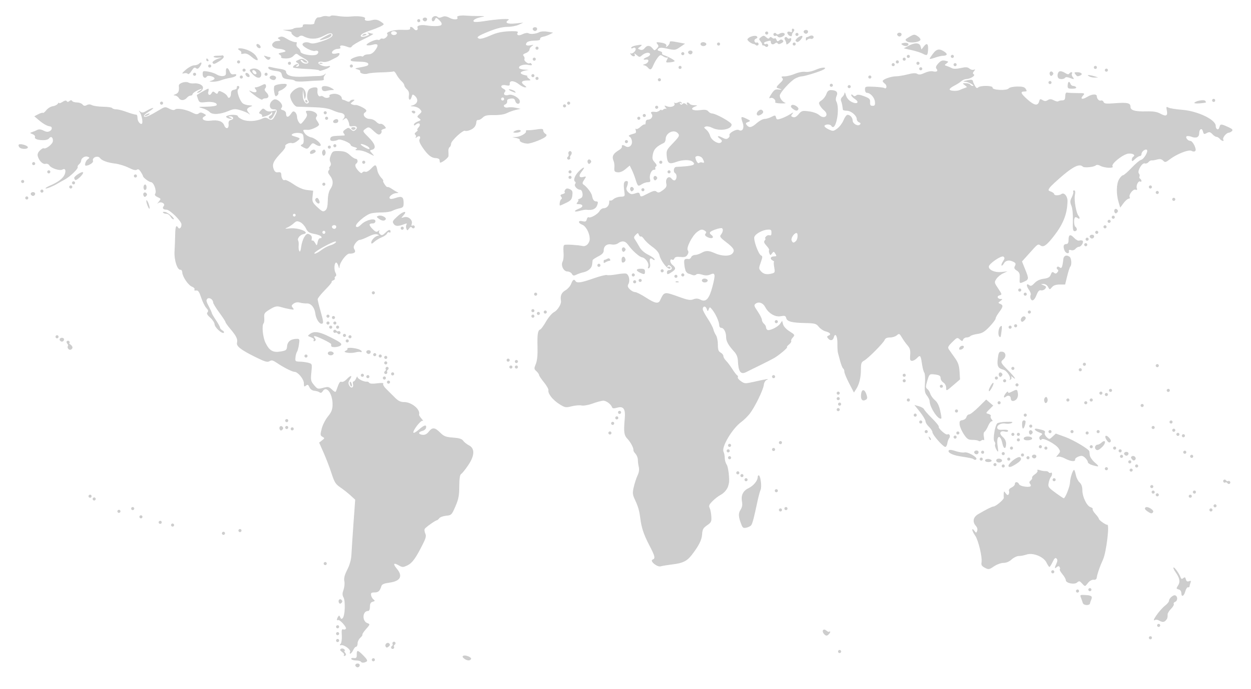
Microsoft Global Network
Greenland
Svalbard
United States
Sweden
Norway
Russia
Canada
United Kingdom
Poland
Ukraine
Kazakistan
Russia
One of the largest private
networks in the world
100K+ miles of lit fiber
130+ edge sites
8,000+ ISP sessions
44 ExpressRoute locations
200+ ExpressRoute Partners
SDN Managed (SWAN, OLS)
France
United States
Turkey
Algeria
Iran
China
Pacific Ocean
Mexico
Atlanta Ocean
Libya
Egypt
Saudi Arabia
India
Myanmar (Burma)
Mali
Niger
Chad
Sudan
Pacific Ocean
Nigeria
Ethiopia
Venezuela
Colombia
Dr Congo
Peru
Angola
Indonesia
Brazil
Zambia
Indian Ocean
Bolivia
Nambia
South Africa
Australia
Owned Capacity
Data center
Argentina
Leased Capacity
Moving to Owned
Edge Site
DCs and Network sites not exhaustive

Slide 13
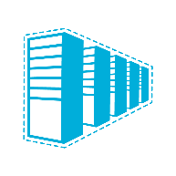
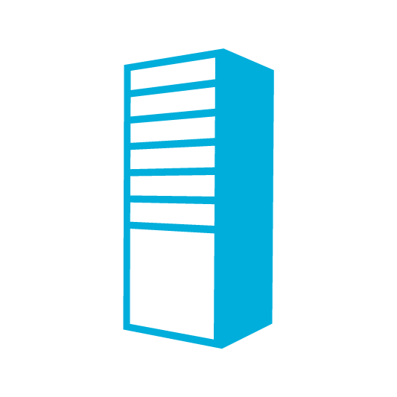
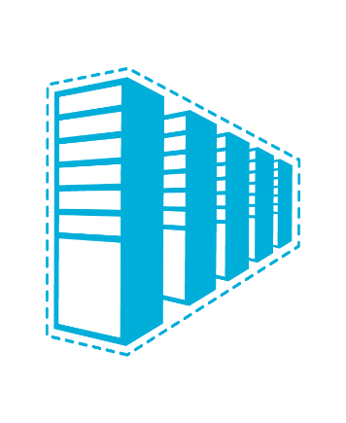


Connectivity options and hybrid offerings
Azure
Customer
Segment and workloads
Consumers
Access over public IP
DNS resolution
Connect from anywhere
Internet connectivity
Developers
POC Efforts
Small scale deployments
Connect from anywhere
Secure point-to-site VPN connectivity
SMB & Enterprises
Connect to Azure compute
Connect branch to branch
Virtual WAN and Site-to-site
VPN connectivity
SMB & Enterprises
Mission critical workloads
Backup/DR, media, HPC
Connect to all Azure services
ExpressRoute private connectivity

Slide 14
Step 2
Execution:
Open a new PowerShell ISE session
Open WorkshopStep2.ps1
(at C:\vdcWorkshop\Scripts)
Run WorkshopStep2.ps1

Slide 15
Step 3
Execution:
Open a new PowerShell ISE session
Open WorkshopStep3.ps1
(at C:\vdcWorkshop\Scripts)
Run WorkshopStep3.ps1

Slide 16
Step 1, 2, and 3 Validation
All resources are now created for the simulated on-prem and vWAN hub.
Take a few minutes in the Azure Portal and validate these resources
Review the HUB:
Azure Portal: https://portal.azure.com, navigate to resource group CompanyXX-Hub01, click into your vWAN CXX-vWAN01
Review the following tabs in the vWAN:
VPN Sites (empty for now but we’ll create some soon)
Hubs (note the VPN Sites value, we’ll add some soon)
Virtual network Connections (no connections, but we’ll add some soon)
SSH to NetFoundry Device (via PowerShell command line window (not ISE!!))
ssh.exe nfadmin@<<Device IP>>
It’s a Linux box so generic Linux commands will work
Type “Exit” to leave the SSH session
SSH to Cisco Device (via PowerShell command line window (not ISE!!))
ssh.exe User01@<<Device IP>> Use the User01 password from Key Vault
It’s a cisco router so you can run commands like “Show Run” to see config
Type “Exit” to leave the SSH session
Once done, close all PowerShell windows

Slide 17
Step 4
Execution:
Open a new PowerShell ISE session
Open WorkshopStep4.ps1
(at C:\vdcWorkshop\Scripts)
Run WorkshopStep4.ps1
Validation:
Browse to your vWAN in the Portal
Look at Virtual Network Connections
You should see two VNets (both Azure sites)
Take Away:
Your Azure VNets are now connected (via VNet peering) to your vWAN Hub

Slide 18
Step 5
Execution:
Open a new PowerShell ISE session
Open WorkshopStep5.ps1
(at C:\vdcWorkshop\Scripts)
Run WorkshopStep5.ps1
Follow activation steps output from script
It will take 10 – 15 minutes for the NetFoundry appliance to register with the NetFoundry service and for the tunnel to come up.
Proceed to Step 5 and we’ll validate this step together with Step 6.

Slide 19
Step 6
Execution:
Open a new PowerShell ISE session
Open WorkshopStep6.ps1
(at C:\vdcWorkshop\Scripts)
Run WorkshopStep6.ps1
Follow activation steps output from script
You’ll need to generate the Cisco VPN config after you log in to the router.
This config is generated by running the Get-CiscoConfig.ps1 in another PowerShell window.
It will take about 2 minutes for the tunnel to come up after completing the router config.

Slide 20
Step 5 and 6 Validation
10.17.xx.4
10.17.xx.36
Validation:
Browse to your vWAN in the Portal
Look at VPN Sites
You should see two Sites (01 and 02)
The Sites should be associated with your hub
The Sites statuses should be “All connected”
From the Site01 VM, try pinging the VM in Azure 01, 10.17.xx.4
From the Site01 VM, try pinging the VM in Site 02, 10.17.xx.164
Take Aways:
Your two “on-prem” sites are now connected to your Azure Virtual WAN. This gives you connectivity to the two Azure Sites and between your two on-premises Sites via the vWAN Hub.
10.17.xx.132
10.17.xx.164

Slide 21
Step 7

Slide 22
Step 8

Slide 23
Final

